Slide 1
Hands-On Workshop: Kinetis Bootloaders - How Do I Interface With It?
FTF-DES-F1299
Eric Ocasio | Freescale Application Engineer
Michael Steffen | Freescale AMR FAE
Roy Wu | Freescale Technical Marketer
JUNE.2015

Slide 2
Agenda
What is Kinetis Bootloader?
What is Supported? – Release Update
Hands-on: Interface with Flash-Resident Bootloader
Hands-on: Interface with ROM Bootloader
Hands-on: Bootloader Minimal Configuration
Q&A

Slide 3

Kinetis Bootloader
Learn more at: www.freescale.com/kboot
Product Features
A common bootloader for Kinetis MCUs
C/C++ Source code provided under a permissive BSD open source license
Serial communications with a host via UART, SPI, I2C, CAN and USB HID
  Active peripheral detection
  Common packet-based protocol for all peripherals
Packet error detection and retransmission
Configurable options for executing bootloader at startup or application runtime
Command-line and GUI tools provided
Designed to be flash, ROM or RAM resident
  Failsafe boot mechanism on Kinetis devices with ROM
  Pre-programmed into flash (on devices without a dedicated ROM) and executed from RAM for built-in factory programming
  Fully customizable for use in customer applications providing reliable field updates
Flash programming over a serial connection: erase, program, verify
Flash, ROM or RAM based bootloader with open-source software and host-side programming utilities.
Software and Hardware
Evaluation & Dev Tools
Customer Application
Stacks
(TCP/IP, USB)
Middleware
Application Specific
Libraries
(DSP, Math, Encryption)
Operating System
BSP, Drivers & HAL
Bootloader
MCU Hardware
The OSI logo trademark is the trademark of Open Source Initiative.

Slide 4


Kinetis Bootloader Configurations
M
Bootloader Source
Freescale validation and automated test
=
ROM Bootloader
(Binary, MCU specific)
Flash-resident Bootloader
(Source, Configurable)
Flashloader
(Binary, MCU specific)

Slide 5
Entering the Bootloader
M
ROM-based Bootloader
Flash-based Bootloader
Bootloader is executed out of reset if either of these are true:
  FOPT[BOOTSRC_SEL] = 0b11 or 0b10
    FOPT is a Flash Option byte at 0x40D in flash — flash erased state defaults to 0b11
  BOOTCFG0 pin is enabled and asserted (FOPT[BOOTPIN_OPT] = 0b0)
A user application may execute the bootloader by calling the bootloader entry point (can be determined programmatically)
Completely configurable by the user
Bootloader is executed out of reset if the Reset Vector points to the bootloader
is_boot_pin_asserted() can be customized to utilize a user-selected GPIO pin
A user application may execute the bootloader by calling the bootloader entry point (can be determined programmatically)
RAM-based Bootloader (Flashloader)
Always executes out of reset
Is intended as a “one-shot” flash programming method

Slide 6
Bootloader Startup Flow (ROM/Default Flash)
M
Boot pin
asserted?
Enter
Bootloader
Disable Timeout
No
No
Initialize
hardware
User
App
valid?
Periph
activity?
Yes
Shutdown
unused periphs and
Enter State Machine
Load user-
config data
(from BCA)
Yes
No
No
Timeout
enabled
& out?
Configure
clocks, periph,
and memory
Enable Timeout
Yes
Shutdown all
peripherals &
Jump to User App

Slide 7
Kinetis Bootloader Release Schedule
R
1.2.0 – July, 2015
Add support for K24F120M, K65F, KV11, KV31, KV46
Add support for CAN interface
Add KDS project examples
Add Mac OS/Linux support for command-line host tool
Dec, 2014
FRDM-K22F
FRDM-KL25Z
July, 2014
FRDM-K64F
1.0.2
1.1.0
1.2.0
KL03Z
KL43Z
K22F 100/120 MHz
…
KL13Z/KL33Z
KL17Z/KL27Z
K24F 256KB flash
K26/K65/K66
…
Security Release – Q4 2015
Encrypted image download support in select devices
Security tool to generate a encrypted .sb image
Updated host tool with commands to program encrypted image
QSPI flash support

Slide 8
Kinetis Bootloader v1.2.0 Release — What’s New?
R
Peripheral Support
UART
USB-HID
I2C Example
SPI Example
CAN Example
Toolchain Project
IAR
KDS
Host Tool Update
Command-line support Windows XP/7/8/8.1,
Mac OS and Linux
Enhanced GUI Tool
New Devices Support*
K26F, K65F and K66F MCUs via the TWR-K65F180M
K24F 120MHz 256KB flash MCUs via the TWR-K24F120M
KV11Z MCUs via the FRDM-KV11Z and TWR-KV11Z128M
KV31Z MCUs via the TWR-KV31F120M
KV40Z, KV43Z, KV44Z and KV46Z MCUs via the TWR-KV46F150M

Slide 9
All Supported Devices
R
Flash-resident Bootloader Project/Source Code
  K24F, K63F and K64F MCUs via the FRDM-K64F and TWR-K64F120M
  K22F 100MHz/120MHz and K02F MCUs via the FRDM-K22F and TWR-K22F120M
  KL25Z MCUs via the FRDM-KL25Z and TWR-KL25Z48M
  K26F, K65F and K66F MCUs via the TWR-K65F180M
  K24F 120MHz 256KB flash MCUs via the TWR-K24F120M
  KV11Z MCUs via the FRDM-KV11Z and TWR-KV11Z128M
  KV31Z MCUs via the TWR-KV31F120M
  KV40Z, KV43Z, KV44Z and KV46Z MCUs via the TWR-KV46F150M
ROM Bootloader
  KL03Z, KL13Z and KL33Z MCUs
  KL17Z, KL27Z and KL43Z MCUs
Flashloader
  K02F and K22F 100MHz/120MHz MCUs,
  K24F 256KB flash MCUs
  K26F, K65F and K66F MCUs
  KV30, KV31 MCUs

Slide 10
Hands-on: Lab #1 – Program the FRDM-K64F board with Freescale’s Flash based Bootloader
M
Lab objective 1 - Learn how to program the FRDM-K64F board with the latest on-line available bootloader.
Lab objective 2 – Download via USB HID using the “Kinetis Updater” and program an application to flash the red LED.

Slide 11
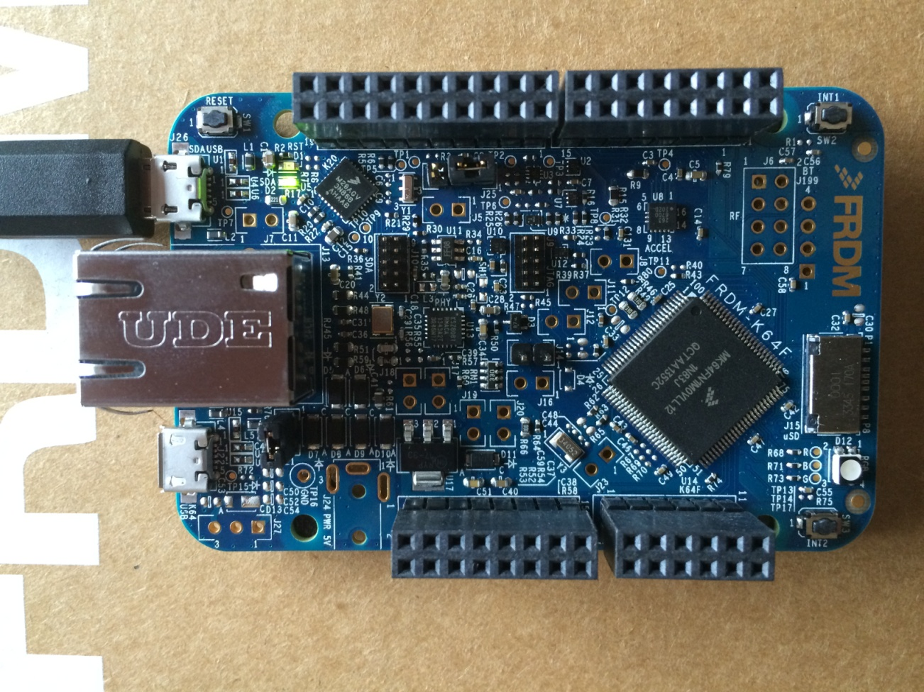
FRDM-K64F Hardware Overview
M
Arduino Expansion Header
Push Button
Reset Button
OpenSDA Debug
FXOS8700CQ
Accel + Mag
K64 Ethernet
MicroSD Card
Tri-Color LED
K64 USB
Push Button
Arduino Expansion Header
MK64FN1M0VLL12
120 MHz, Cortex-M4, 1MB Flash,
256K SRAM, Ethernet, USB, 16-bit ADC,
12-bit DAC, SDHC

Slide 12

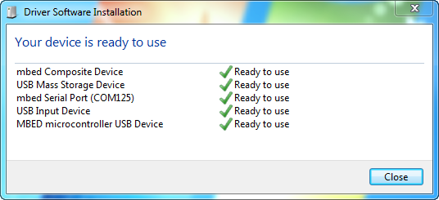
Setting up FRDM-K64F Board
M
Plug-in the USB cable (OpenSDA port)
Green LED should be solid
Let the drivers install…you should see this similar message before continuing the lab.
Green LED Solid
USB Connection

Slide 13
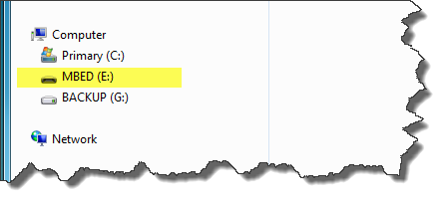
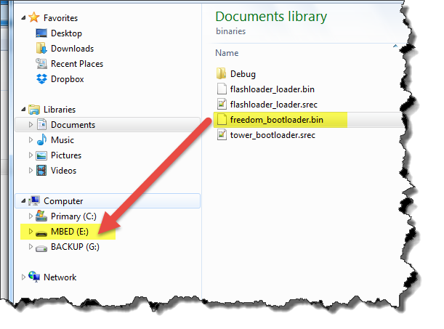
Loading Bootloader Firmware on FRDM-K64F Board
M
You should now see the MBED (drive:) appear
Located the file called “freedom_bootloader.bin”, located here:
C:\FTF-DES-1299\Kinetis_Bootloader_1_2_0\targets\MK64F12\binaries
Drag and drop the file “freedom_bootloader.bin” onto MBED(drive:)

Slide 14
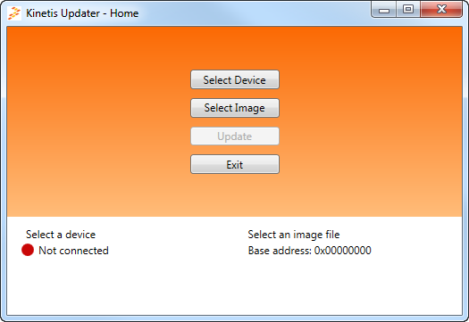
Connecting to the “Kinetis Updater”
M
Open the program KinetisUpdater.exe located at:
C:\FTF-DES-F1299\Kinetis_Bootloader_1_2_0\bin\win\KinetisUpdater

Slide 15
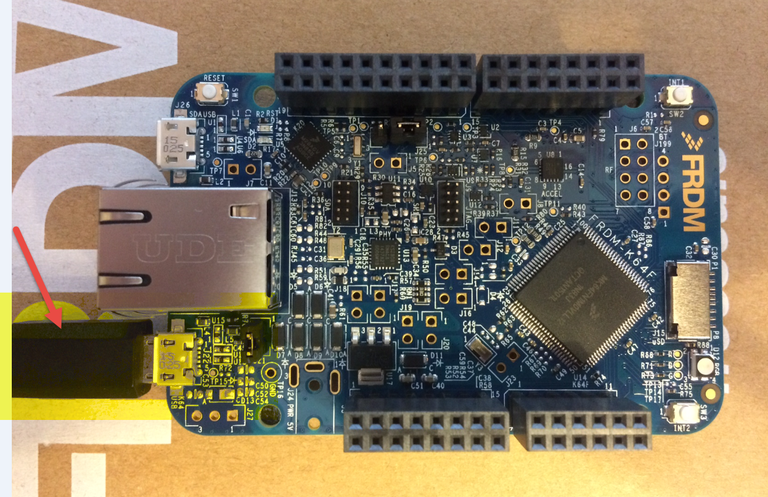
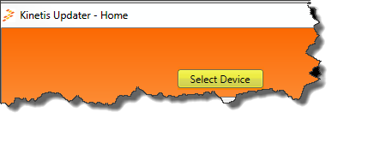
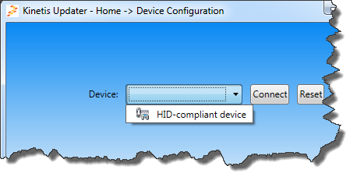
Connecting to the “Kinetis Updater” – using HID
M
Move the USB micro cable from the top USB (OpenSDA) connector to the bottom USB connector (J22). We are now communicating with the USB port on the K64F MCU directly.
On the “KinetisUpdater” GUI, follow these steps:
Press the “Select Device”
Drop down the “Device” box and select “HID-compliant device”

Slide 16
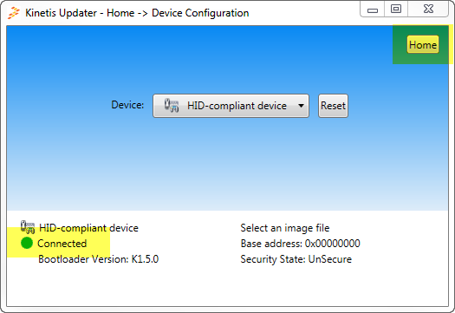
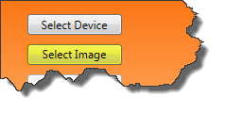
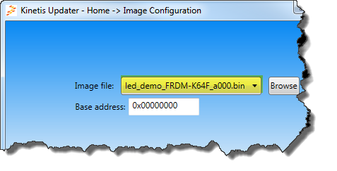
Programming an Application using the “Kinetis Updater”
M
You should now see the “Kinetis Update GUI is now “Connected”.
Do not continue the lab if the green dot does not appear connected.
Press the “Home” in the upper right corner.
On the “KinetisUpdater” GUI, follow these steps:
Press the “Select Image”
Press the “Browse” and locate this file:
You should have this .bin file appear as the “Image file:”
C:\Kinetis_Bootloader_1_2_0_rc1.1\Kinetis_Bootloader_1_2_0\apps\led_demo\
binaries\ led_demo_FRDM-K64F_a000.bin

Slide 17
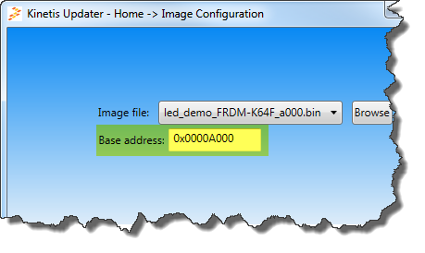
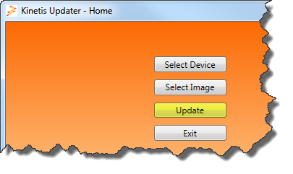
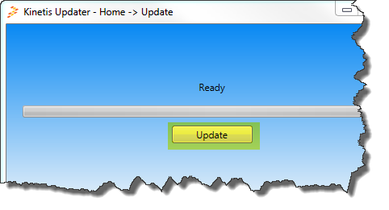
Programming an Application using the “Kinetis Updater”
M
3. Change the “Base address” to 0x0000A000
3. Press the “Home” Button in the upper right corner.
3. Press the “Update” button
4. Press the “Update” on the next screen

Slide 18
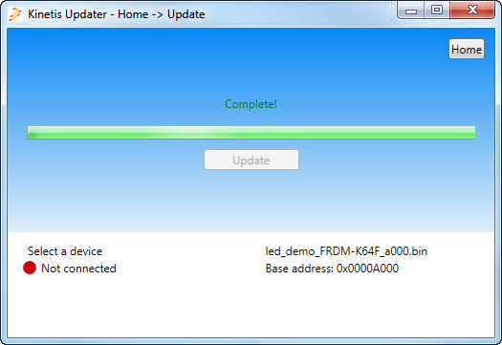
Programming an Application using the “Kinetis Updater”
M
The Red/Blue LED should be flashing in the board, and the “Kinetis Updater” GUI should be disconnected now.
Please close the GUI and proceed to next lab.

Slide 19
Hands-on: Lab #2 – How to interface with the FRDM-KL03Z board with Freescale’s ROM based Bootloader
M
Lab objective 1 - Learn how to interface with the FRDM-KL03Z board’s built-in ROM based bootloader.
Lab objective 2 – Download via UART using “Command line” to ping, erase, and program an application to flash the red LED.
Lab objective 3 – Understand how the FOPT (flash option register ) settings are used to gain entry into the bootloader.
Lab objective 4 – Understand how gain entry into the bootloader from user application code.

Slide 20
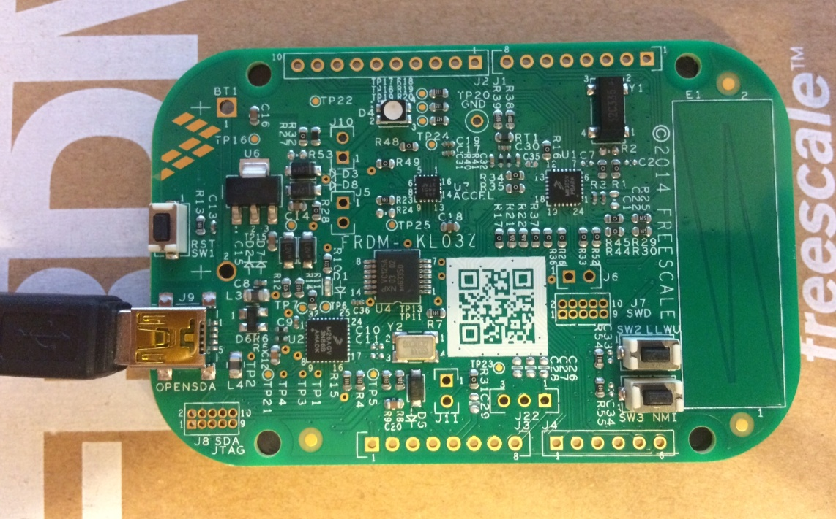
FRDM-KL03Z Hardware Overview
M
Arduino Expansion Header
MMA8491
Accelerometer
Reset Button
Tri-Color LED
SW2 Push Button
SW3 Push Button
OpenSDA Debug
Arduino Expansion Header
MKL03Z16VFK4
48 MHz, Cortex-M0+, 16KB Flash,
2K SRAM, Low Power, ROM based Bootloader

Slide 21

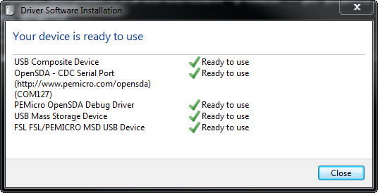
Setting up FRDM-KL03Z Board
M
Plug-in the USB cable (OpenSDA port)
Green LED should be solid
Let the drivers install…you should see this similar message before continuing the lab. NOTE: Before you close this window, write down the COM port #. In the example to the right, it’s COM127.
USB Connection
Green LED Solid

Slide 22
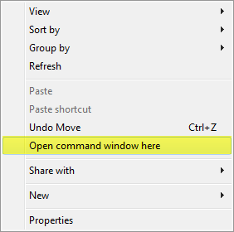
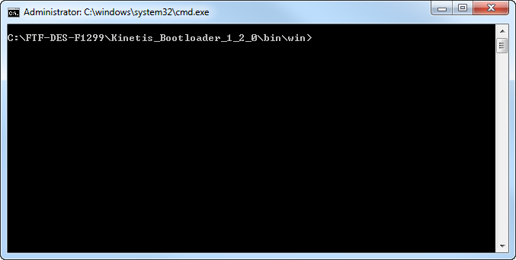
Loading Bootloader Firmware on FRDM-KL03Z Board
M
Open Windows Explorer and migrate to this directory in Windows,
C:\FTF-DES-F1299\Kinetis_Bootloader_1_2_0\bin
Open a terminal window in this location by holding down the SHIFT key + mouse right click
You should have this CMD window in this directory:

Slide 23
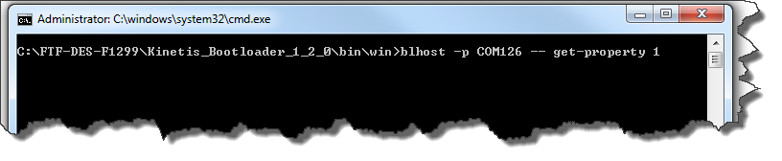
Communicating via UART to the KL03 Bootloader
M
In the command window, type this command (don’t press ENTER yet):
blhost –p com<#> -- get-property 1
Hold down the “RESET Switch”
and the “SW3 Switch”, then release
“RESET Switch”, and then
the release “SW3 Switch”.
Now press ENTER in the
CMD window.
RESET Switch
SW3 Switch

Slide 24
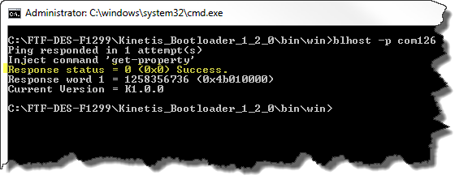
Communicating via UART to the KL03 Bootloader
M
You should see this message: Response status” = 0(0x0) Success
This means you are successfully communicating to the ROM bootloader.
If you get any other error messages, retry the last three steps on the previous slide.

Slide 25
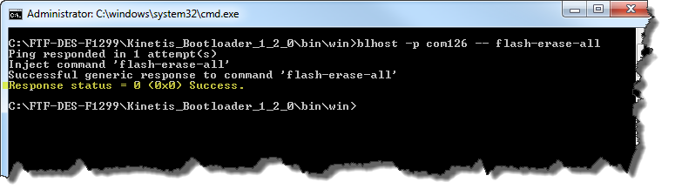
ERASE Flash via UART to the KL03 Bootloader
M
Now, lets erase the entire contents of flash…
In the command window, type this command
blhost –p com<#> -- flash-erase-all
You should see this message: Response status” = 0(0x0) Success
This means you have successfully erased the entire contents of flash.

Slide 26
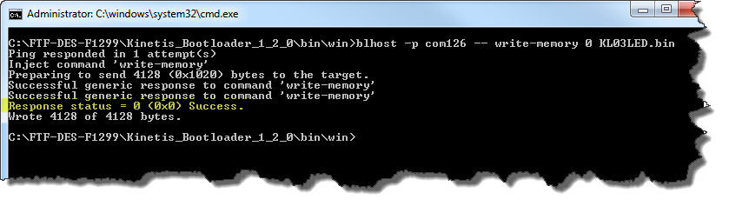
PROGRAM Flash via UART to the KL03 Bootloader
M
Now, lets program the contents of flash from a binary file called “KL03LED.bin”…
In the command window, type this command:
blhost –p com<#> -- write-memory 0 KL03LED.bin
You should see this message: Response status” = 0(0x0) Success
This means you have successfully programmed the file “KL03LED.bin to the flash memory.
Now, to execute the code from flash, press the RESET button on the FRDM-KL03Z board. This will disconnect the bootloader from the PC.
The board will wait 5 seconds, then start executing from
flash memory at 0x0000000, or the reset vector. The red, green, and blue, LED should flash one second intervals.

Slide 27
Explanation of the bootloader commands:
M
Let’s take the example of the write-memory command
blhost –p com<#> -- write-memory 0 KL03LED.bin
File binary or .srec used to program memory
Starting address where memory will be written
Bootloader commands (ping, erase-memory, get-property)
For list of commands, type blhost --help in CMD window
COM port # for UART (located in Windows DEV MGR)
-p => communicating via UART, -u is USB HID
Bootloader execution program

Slide 28
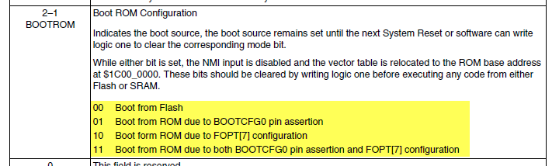
Understanding the different methods of entry into the bootloader
M
For the labs, we were entering the Bootloader using the NMI pin from the MCU (connected to switch SW3).
The bootloader also has a timeout mechanism. Meaning, the flash application code will not execute until the five seconds (configurable, default is 5 seconds) after a reset has occurred.
In the datasheet, section 21.2.6, RCM Module, there are 4 options for entering the bootloader from RESET.

Slide 29
Program the bootloader with different/no entry methods
M
Option 1: Program the application to ALWAYS execute from flash immediately upon reset.
Option 2: Program the application to only execute from the bootloader if the RESET switch and NMI pin is asserted low upon RESET.
Option 3: Program the application to always jump into the bootloader and timeout after 5 seconds from RESET if communications have not been established.
Option 4: Program the application to jump into the bootloader from the user’s code without using RESET or the NMI switch.

Slide 30
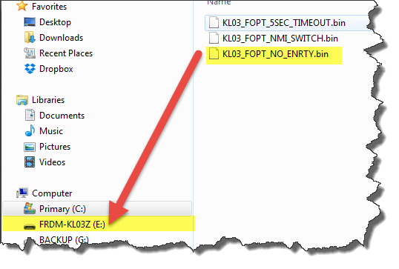
OPTION 1 – LAB: No bootloader entry
M
Open Windows Explorer, and drag and drop the file called:
C:\FTF-DES-F1299\Kinetis_Bootloader_1_2_0\FOPT\ KL03_FOPT_NO_ENRTY.bin
Unplug and plug back in the USB cable
Notice that the code starts executing immediately and ignores any method of entry into the bootloader.
Hold down the “RESET Switch” and the “SW3 Switch”, then release “RESET Switch”, and then release “SW3 Switch”. NOTHING HAPPENS! Code continues to execute.
Register Setting Used in Binary:
FOPT = 0xFFFF30FE

Slide 31
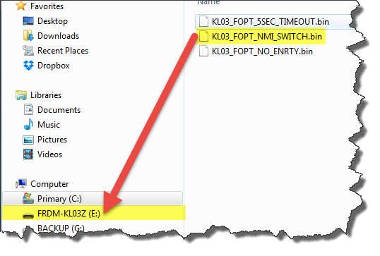
OPTION 2 – LAB: NMI Switch bootloader entry
M
Open Windows Explorer, and drag and drop the file called:
C:\FTF-DES-F1299\Kinetis_Bootloader_1_2_0\FOPT\ KL03_FOPT_NMI_SWITCH.bin
Unplug and plug back in the USB cable
Notice that the code starts executing immediately, but will enter bootloader mode if NMI switch is low at reset.
Hold down the “RESET Switch” and the “SW3 Switch”, then release “RESET Switch”, and then release “SW3 Switch”. Notice the LEDs are not flashing. Now it jumps into the bootloader until the reset switch is hit again.
Register Setting Used in Binary:
FOPT = 0xFFFF3DFE

Slide 32
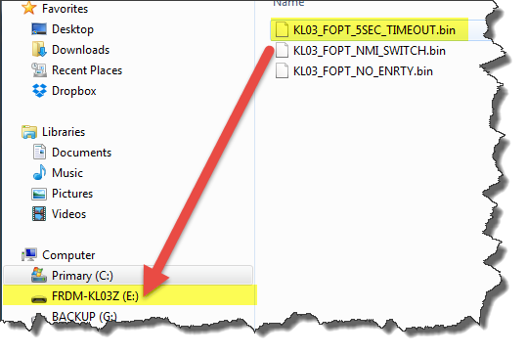
OPTION 3 – LAB: Timeout bootloader entry
M
Open Windows Explorer, and drag and drop the file called:
C:\FTF-DES-F1299\Kinetis_Bootloader_1_2_0\FOPT\ KL03_FOPT_5SEC_TIMEOUT.bin
Unplug and plug back in the USB cable
Notice now that the code starts executing after 5 seconds of timeout. It will enter bootloader mode if NMI switch is low at reset.
Hold down the “RESET Switch” and the “SW3 Switch”, then release “RESET Switch”, and then release “SW3 Switch”. Notice the LEDs are not flashing. Now it jumps into the bootloader until the reset switch is hit again.
Register Setting Used in Binary:
FOPT = 0xFFFFFFFE

Slide 33
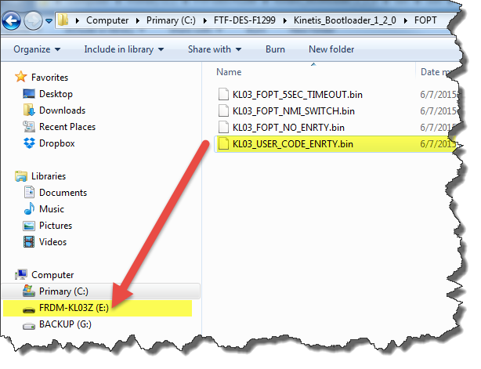
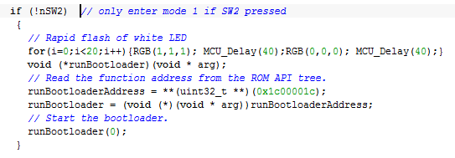
OPTION 4 – LAB: Bootloader entry from user code
M
Open Windows Explorer, and drag and drop the file called:
C:\FTF-DES-F1299\Kinetis_Bootloader_1_2_0\FOPT\KL03_USER_CODE_ENTRY.bin
Unplug and plug back in the USB cable
Notice now that the code starts executing immediately after RESET.
Hold down the “SW2 Switch” until the LED starts flashing white. This is simulating entry into the bootloader from the user /application code memory location. Notice the LEDs are not flashing anymore. You can use the Get-Property command (in the pervious sides) to check if the bootloader is communicating.

Slide 34
Hands-on: Lab #3 – Bootloader Minimal Configuration for FRDM-K64F Flash-resident Bootloader
E
Lab objective 1 – Analyze standard flash-resident bootloader code size
Lab objective 2 – Understand configuration macro options
Lab objective 3 – Learn how to customize the flash-resident bootloader and reduce the code size

Slide 35
Default Flash-Resident Bootloader Configuration
E
All peripheral interfaces enabled:
  UART
  I2C
  SPI
  USB HID
All supported features and commands enabled:
  All erase options (region, all, unsecure)
  Read, Write and Fill memory
  Flash security
  Secure binary (where applicable)
  Run-time control (reset, execute)
  More...
Default configuration code size (IAR 7.30.3, high optimization):
  Code: 22146
  RO data: 1322
  RW data: 4090

Slide 36
Configuration Macro Examples
E
Peripheral interface macros:
  BL_CONFIG_SCUART
  BL_CONFIG_I2C
  BL_CONFIG_DSPI
  BL_CONFIG_USB_HID
Feature/behavior configuration macros:
  BL_MIN_PROFILE
  BL_FEATURE_ENCRYPTION
  BL_FEATURE_READ_MEMORY
  BL_FLASH_VERIFY_DISABLE
  BL_HAS_MASS_ERASE
  BL_FEATURE_POWERDOWN
  BL_ENABLE_CRC_CHECK

Slide 37
BL_MIN_PROFILE Macro
E
Used to reduce flash-resident bootloader to the lowest code size configuration.
Removes the following functionality:
  Read and Fill memory
  Secure binary / encryption
  Mass erase with unsecure
  Call command (execute a function at specific address)
UART-only with BL_MIN_PROFILE code size (IAR 7.30.3, high opt.):
  Code: 9540
  RO data: 572
  RW data: 1737

Slide 38
Let’s Do It - Lab Steps
E
Open bootloader project in IAR
Build bootloader as-is, evaluate code size
Create UART-only bootloader, evaluate size
Create UART-only minimal profile bootloader, evaluate size

Slide 39
Open Bootloader in IAR
E
Open IAR Embedded Workbench by browsing to Start > All Programs > IAR Systems
Select File > Open > Workspace...
Select the workspace file (bootloader.eww) in:
C:\FTF-DES-1299\Kinetis_Bootloader_1_2_0/targets/MK64F12

Slide 40
Build the Bootloader “as-is”
E
Set the “freedom_bootloader” project as active
Click on the “Make” icon to build the application

Slide 41
Evaluate Code Size
E
After the build completes, open the MAP file. For convenience, the MAP file is linked in the “Output” folder of the project.
Browse to the very bottom of the MAP file and note the size.

Slide 42
Create UART-only Bootloader
E
Open the bootloader_config.h file in the “k64f12” folder of the project
Change the peripheral configuration macros as shown below
Save the changes, and re-build the application
Evalute the new code size in the MAP file
From:
To:

Slide 43
Create UART-only Minimal Profile Bootloader
E
Go back to the bootloader_config.h file in the “k64f12” folder of the project
Keep the changes from the UART-only configuration, but add the following code to the header file:
Save the changes, and re-build the application
Evalute the new code size in the MAP file

Slide 44
Demo: SPI interface with FRDM-KL25Z and FRDM-KL03Z
E

Slide 45
Q&A
Do you fully understand - what is Kinetis Bootloader? How does it work? Any question on what is supported?
Do you feel that you have the necessary skill to interface with the bootloader under various settings?
Are you able to re-create the lab and configure the bootloader by yourself?

